Slide 1
Cross Band Transponder (XBT) or Multi-Channel FM Transponder
Andrew Robinson
KA3WDW
30Apr2024
Special Acknowledgement: Dr. Joseph DiVerdi

Slide 2
Review Objectives
Share current progress on concept
Engage community to gather comments, use cases, ideas, thoughts, opinions, etc.
Solicit help to continue this work

Slide 3
High Level Needs (from Jonathan’s email)
Start with:
Single signal path
VHF voice signal transponded as a UHF voice signal
Could be a SDR w/digital radio chip
Could be analog
Fit onto a CubeSat board
Ideally 2” x 2” area
Radiation tolerant
Avoid CMOS

Slide 4
Goals
Multiple transponders on a single satellite
I.e., multiple up frequencies with multiple down frequencies
Low SWaP-C
Other desired capabilities?
Brainstorm session to build a “wish list”

Slide 5
Concept of Operations (CONOPS)

Slide 6
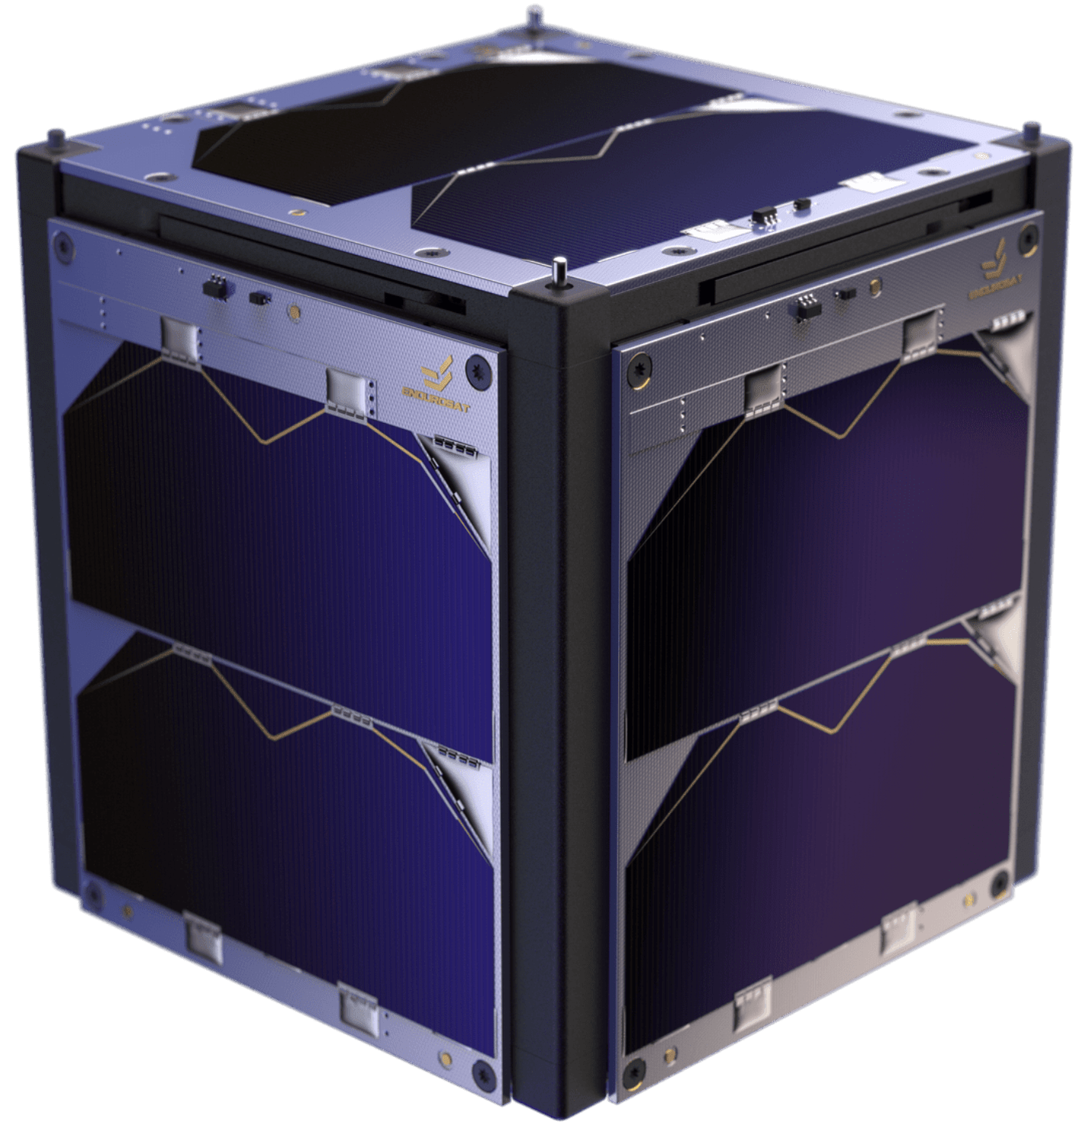




OV-1
Multiple (how many?) transponders on a single satellite
Up in VHF
Down in UHF
f_{UHF,N}
f_{UHF,1}
f_{UHF,2}
f_{VHF,N}
f_{VHF,1}
f_{VHF,2}

Slide 7
CONOPS
Main mission:
Receive TBD number of VHF signals from aperture
Amplify/filter/condition incoming signals for processing
Process signals
Filter/condition/amplify outgoing signal
Transmit UHF signals to aperture
Other Use Cases:
SOH, failure recovery
Store and forward?
Software updates
Different/new/etc. modes

Slide 8
Architecture

Slide 9
High-Level Block Diagram
144-146 MHz
420-450 MHz
LNA
PA
Down
Converter
Up
Converter
Signal
Processor
ADC
DAC
System of Interest

Slide 10
Context Diagram
Cross Band Transponder
Power
Commands
Host Bus
Tx Signals
Apertures
TLM
Rx Signals
Will the Bus have a comm system for TLM D/L or will the XBT be used?

Slide 11
Cross Band Transponder
To Components
Processor
DC/DC
Digital Up-converter
DAC
Tx Front End
PA
Power
Tx
Signals
Commands
Digital Down-converter
ADC
Rx Front End
TLM
Rx
Signals
RFIC
Reference signal: needed? (probably) → internal or external?

Slide 12
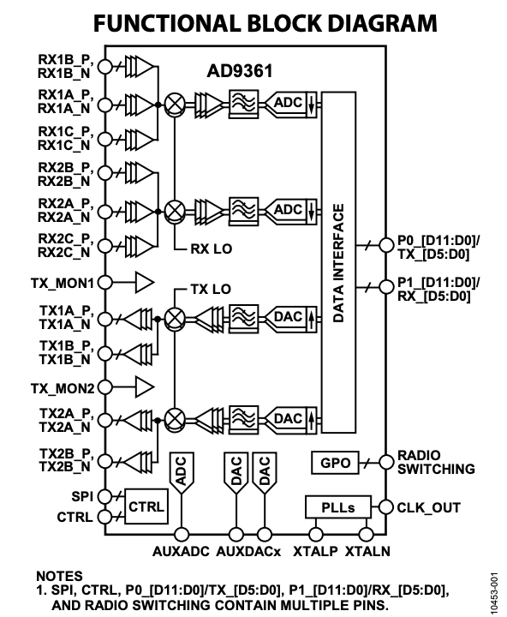
RFIC
Functionality needed:
Analog receive
Amplify
Mix with LO to IF
ADC
DAC
Mix with LO to RF
Analog transmit
Baseline: Analog Devices AD9361
12-bit DAC and ADC’s
TX: 47 MHz to 6.0 GHz, RX: 70 MHz to 6.0 GHz
Other options?
From AD9361 Data Sheet

Slide 13
Processor
Functionality needed:
Demodulate signal
Shift signal
What else..??
Notes/Questions/Observations:

Slide 14
Processor Exploration – scratch the ASCENT itch
Prompted a variety of LLM’s to brainstorm low power processor options:
TI Tiva C Series
STMicroelectronics STM32F7 Series
Microchip Technology PIC32MX Series
NXP Semiconductors i.MX6 Series
Espressif Systems ESP32/ESP8266
TI TMS320C6000 Series → see follow-on slide
Xilinx Zynq UltraScale+ MPSoC
Analog Devices ADSP-SC58x/ADSP-2158x
Microchip dsPIC33CH
Renesas R-Car V3H

Slide 15
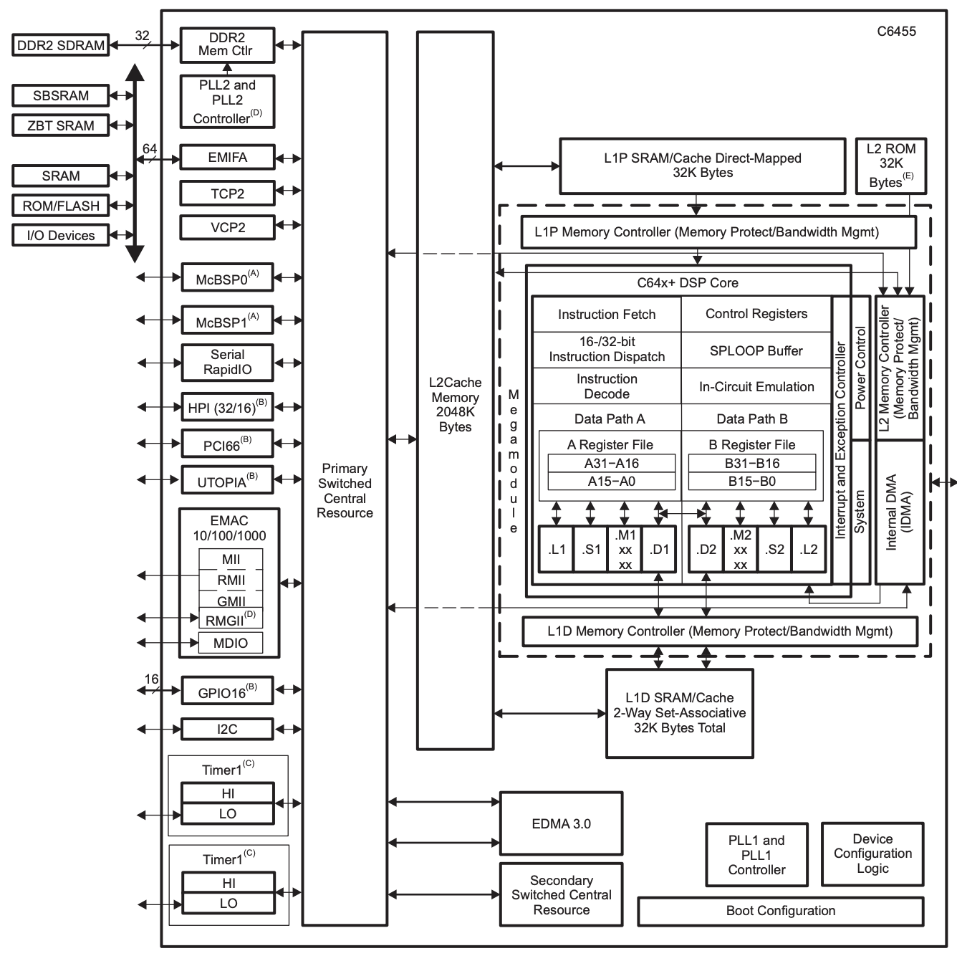
Processor Option (1 of n)
TI TMS320C6000 Series
High performance DSP w/low power
Very Long Instruction Word (VLIW) → efficient parallel processing
E.g., TMS320C6455BCTZA
-40C to 90C
1 GHz clock rate
$291.15 and 43 in stock (DigiKey)
Evaluation board: TMDXEV6455
$1,895.52 and 1 in stock (DigiKey)
Radiation-hardened version available → SMJ320C6701-SP

Slide 16
Processor Option (2 of n)
WIP

Slide 17
Power Amplifier (PA)
Functions → Form:
Amplify the RF signal
Notes/Questions/Observations:
What power is required to close the link?
Frequency, aperture, altitude dependent?

Slide 18
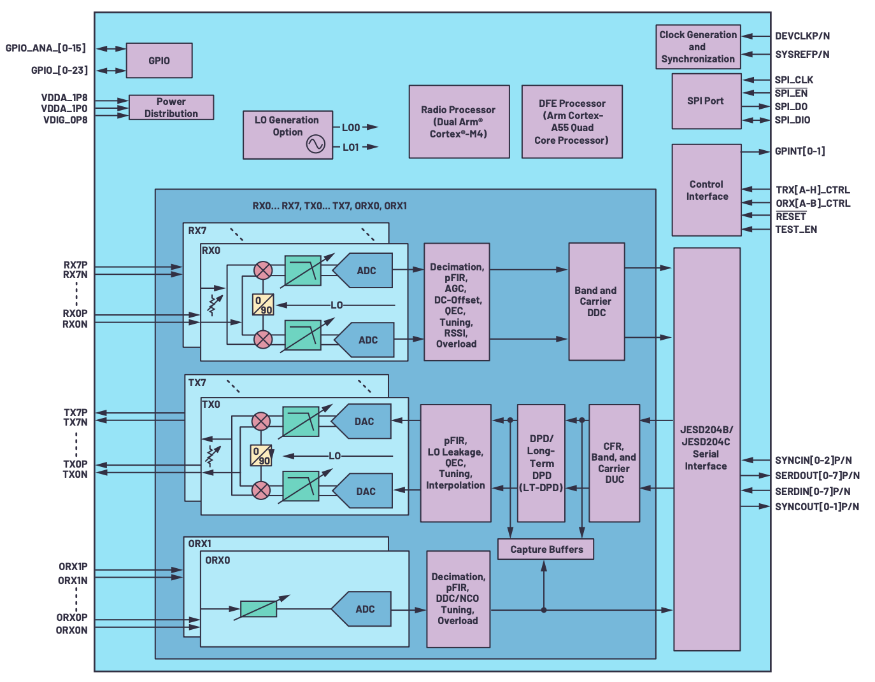
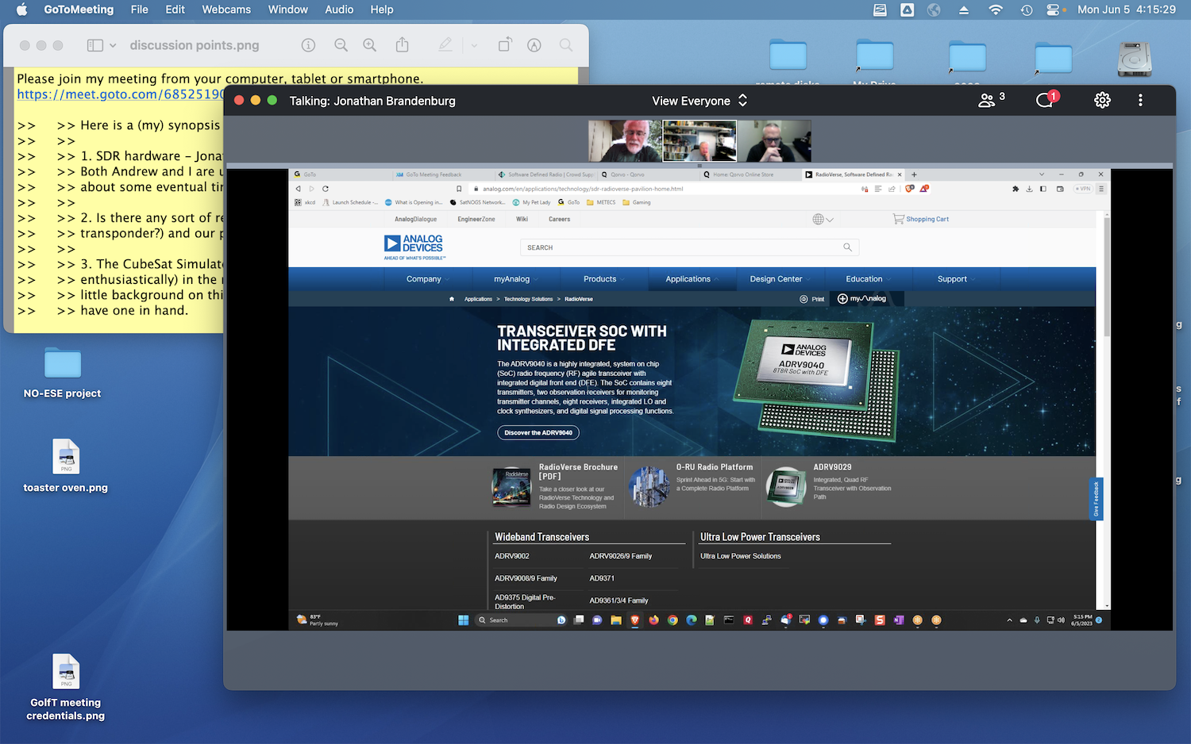
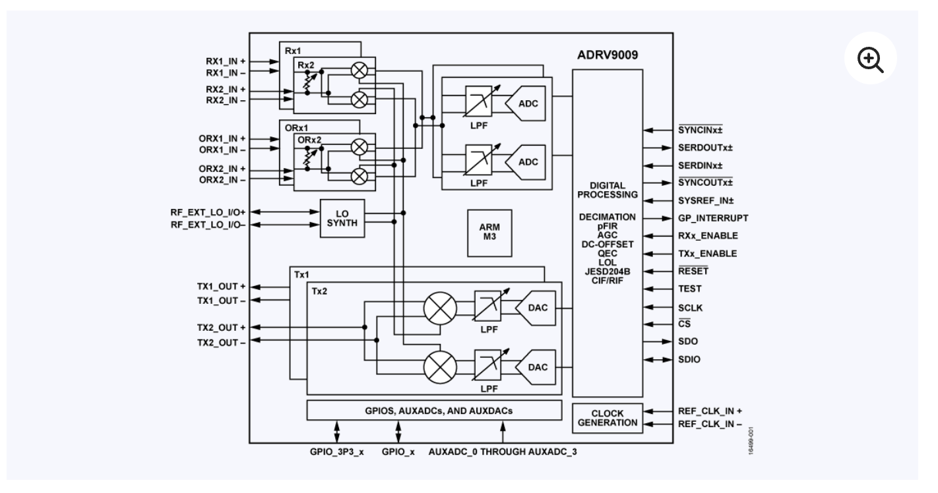
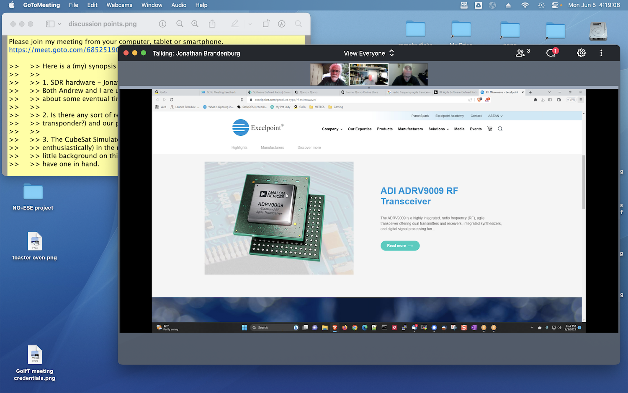
Other Potential Components to Explore
ADRV904x Block Diagram

Slide 19
Prototyping

Slide 20
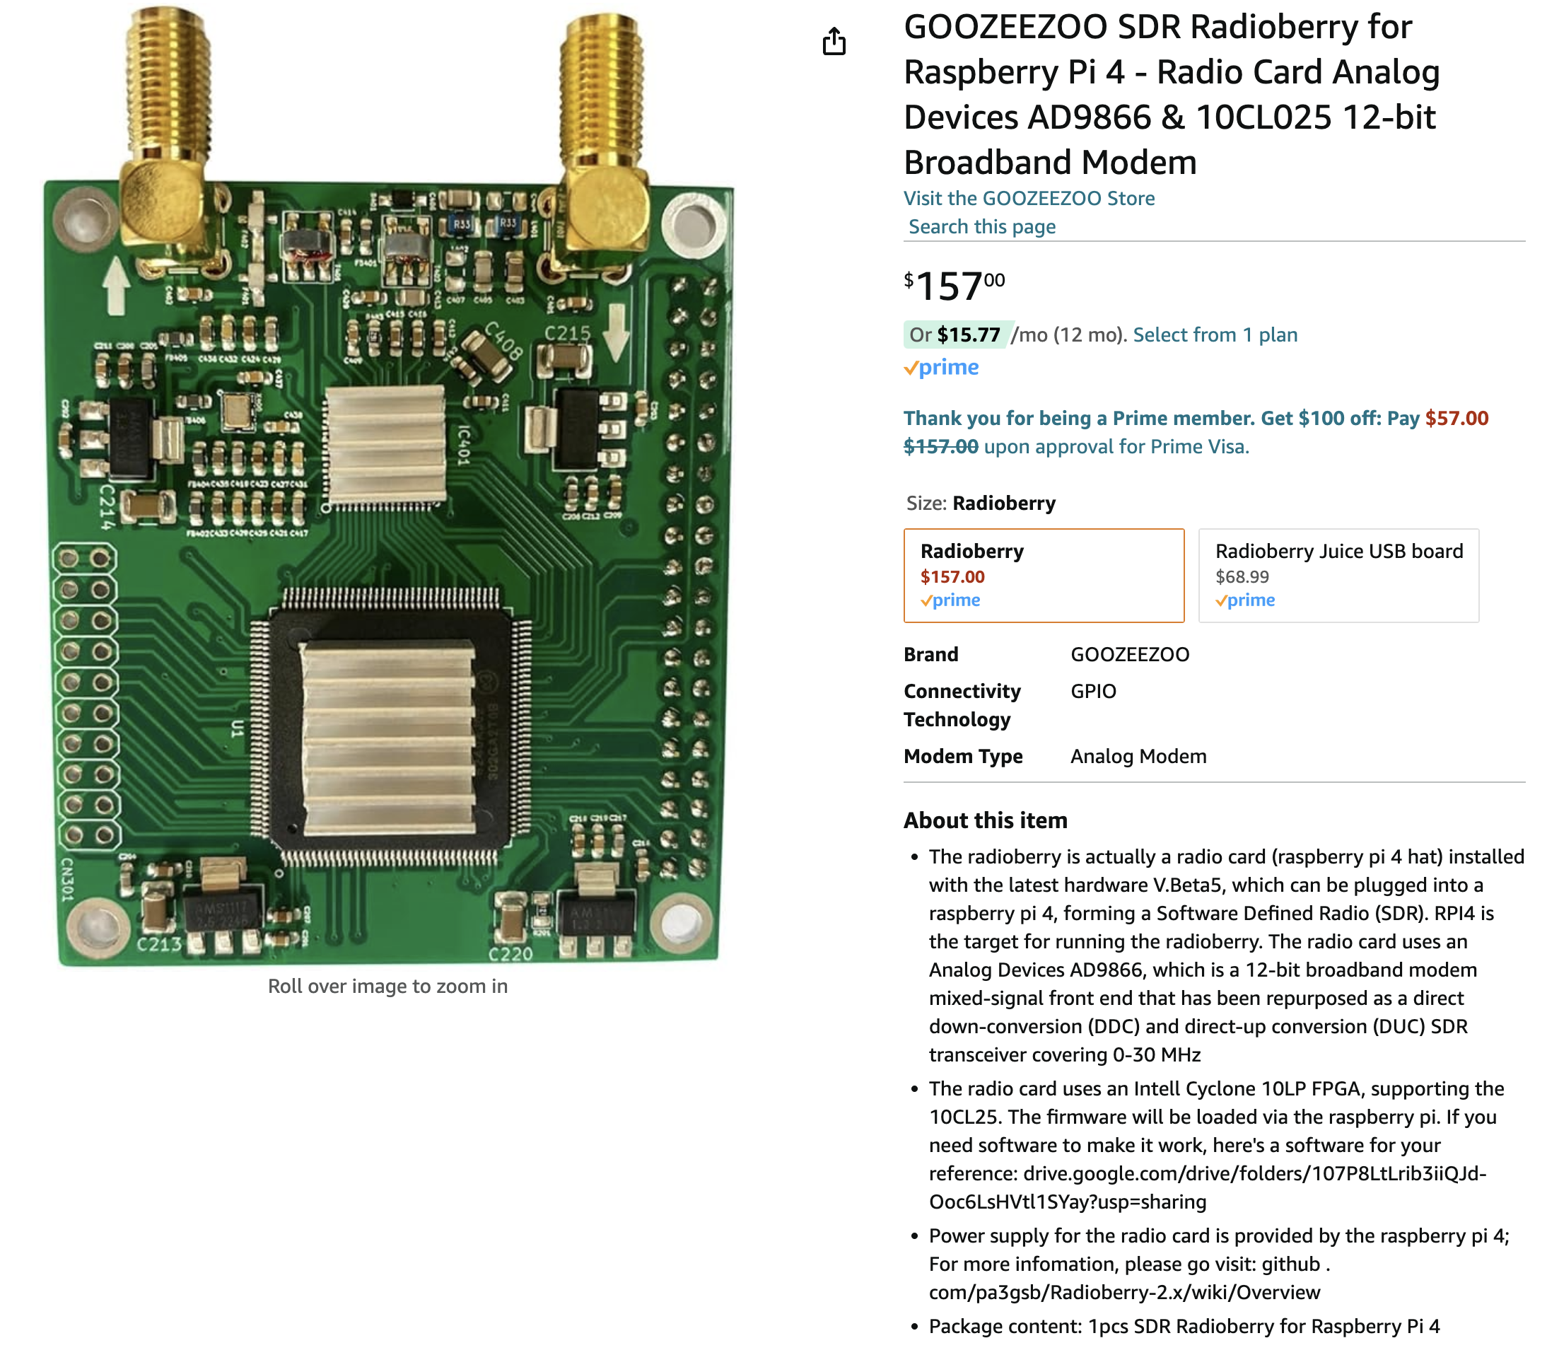
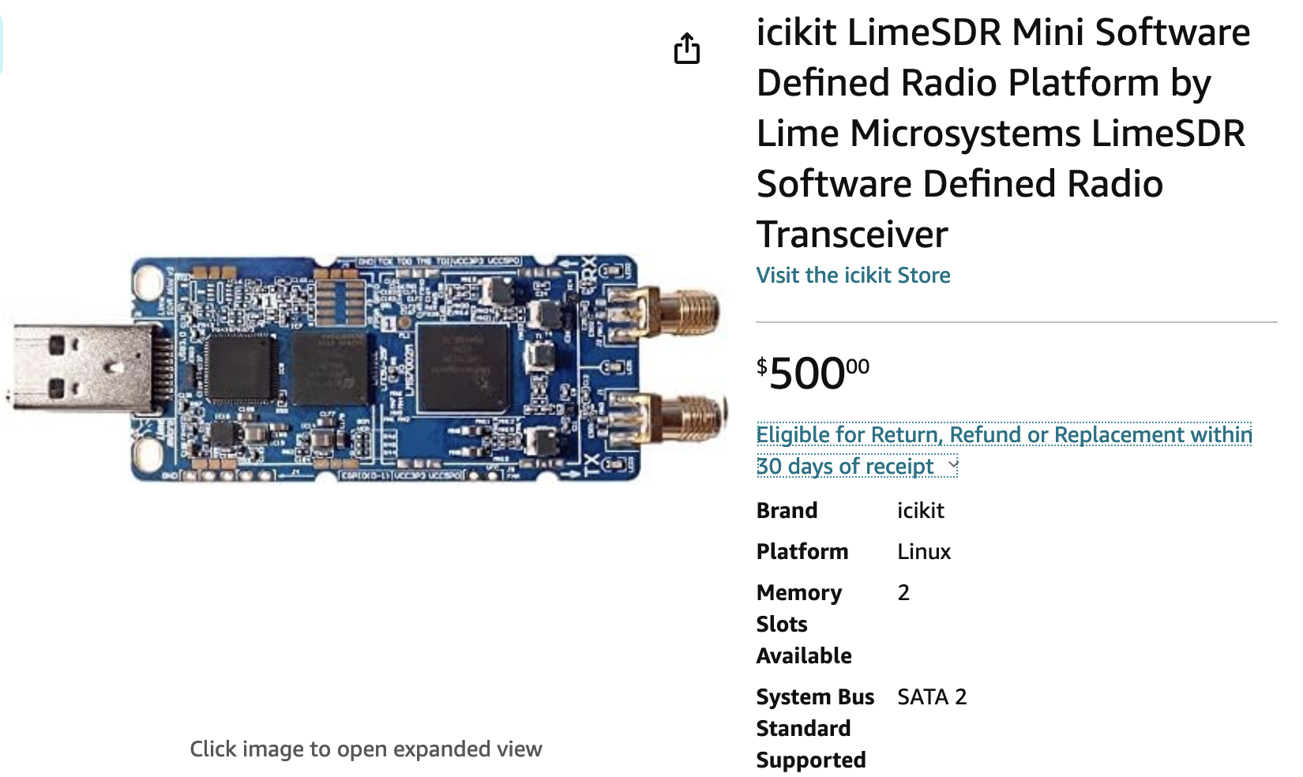
Early Prototyping Ideas
Potential Options:
Radioberry w/Raspbery Pi (and required converters)
LimeSDR
Others?
Purpose: Exploration on non-flight COTS parts to gain confidence/experience while going through conceptual design

Slide 21
Acronyms
Acronym | Definition
ADC | Analog to Digital Conversion
COTS | Commercial Off The Shelf
D/L | Downlink
DAC | Digital to Analog Conversion
DC | Direct Current
FM | Frequency Modulation
IF | Intermediate Frequency
LNA | Low Noise Amplifier
LO | Local Oscillator
PA | Power Amplifier
RF | Radio Frequency
RFIC | Radio Frequency Integrated Circuit
Rx | Receive
SDR | Software Defined Radio
TLM | Telemetry
Tx | Transmit
U/L | Uplink
XBT | Cross Band Transponder

Slide 22
Backup

Slide 23
Assumptions
# | Title | Assumption
1 | Input Power | A single source of power will be received from the bus Conversion and distribution of power is a function of the XBT
2
3
4
5
6
7
8

Slide 24
High-Level Questions
# | Question | Response
1 | Are there any desired additional capabilities that we can enhance with a digital design or a SDR design?
2
3
4
5
6
7
8

Slide 25
Requirements(-ish)

Slide 26
Design-y Questions
# | Question | Response
1 | What TLM is typically collected?
2 | How many signals?
3 | What is a good power draw to shoot for?
4 | Are reference signals (e.g., PPS, 50 MHz) available from the bus or should they be accounted for on the XBT?
5
6
7
8

Slide 27
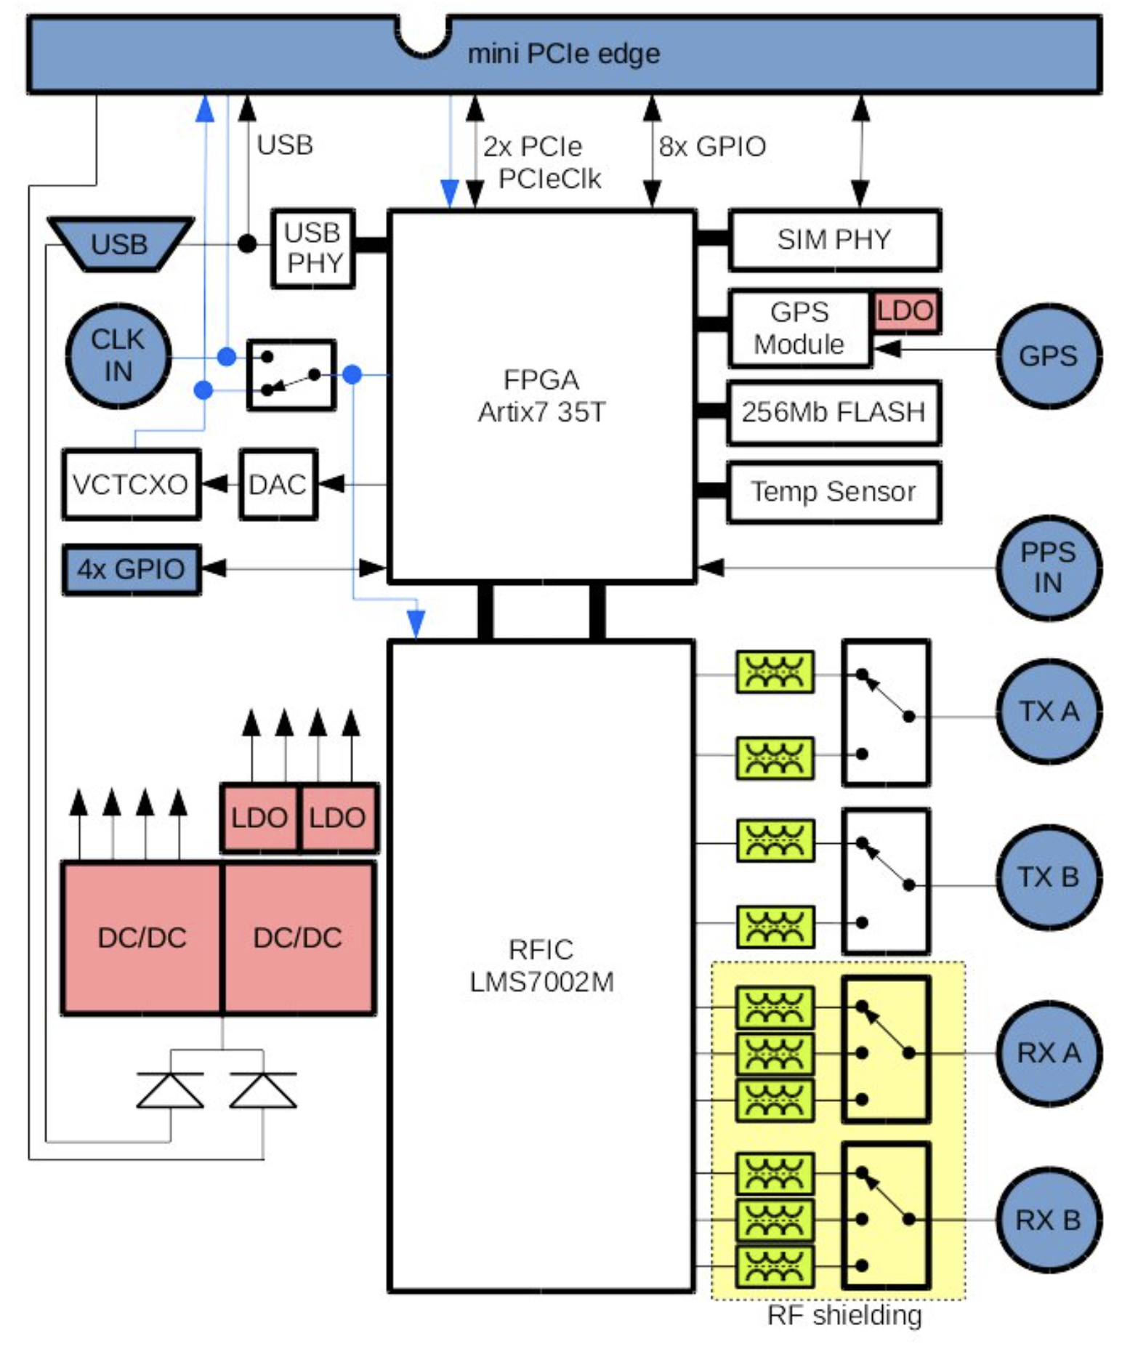
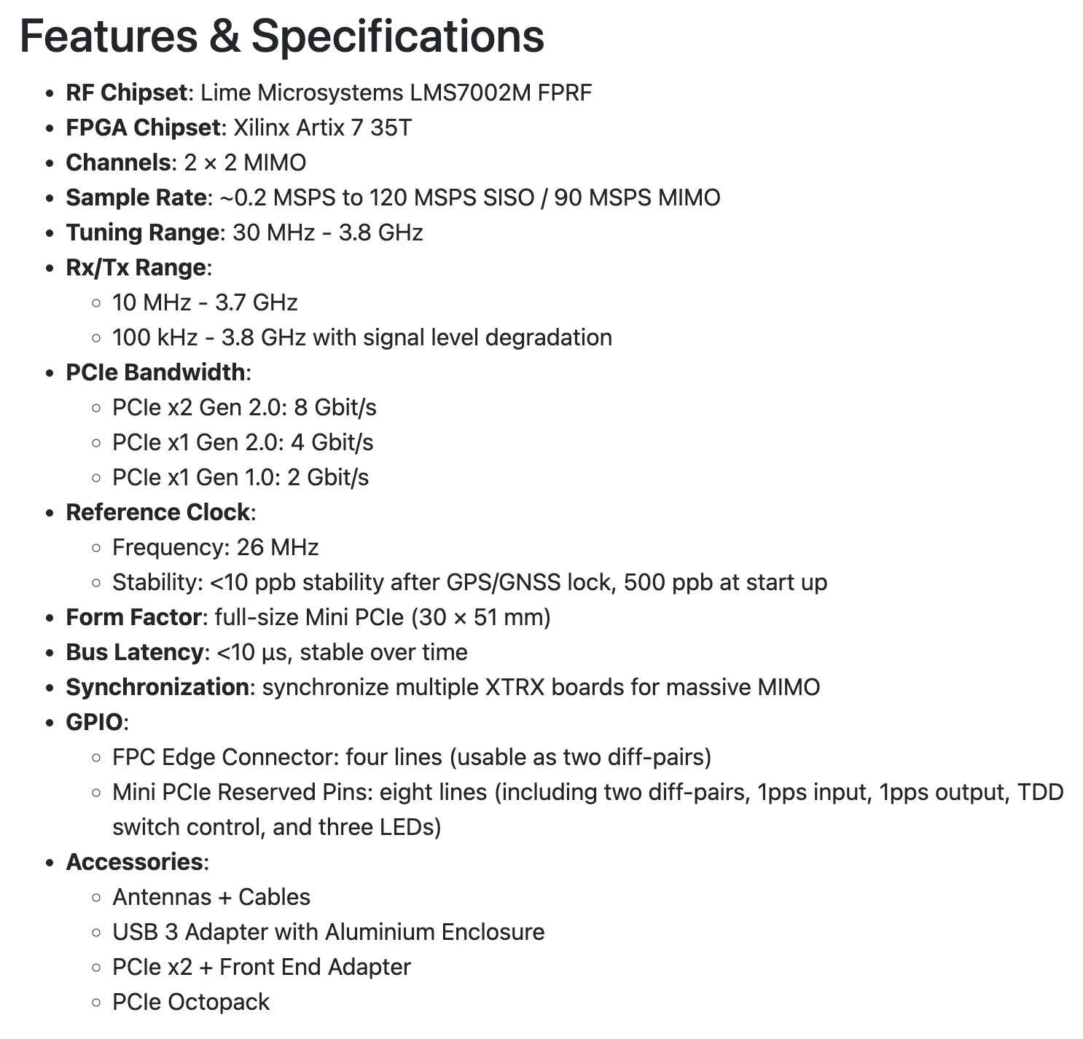
SDR
Fairwaves
XTRX
Source: https://www.crowdsupply.com/fairwaves/xtrx

Slide 28
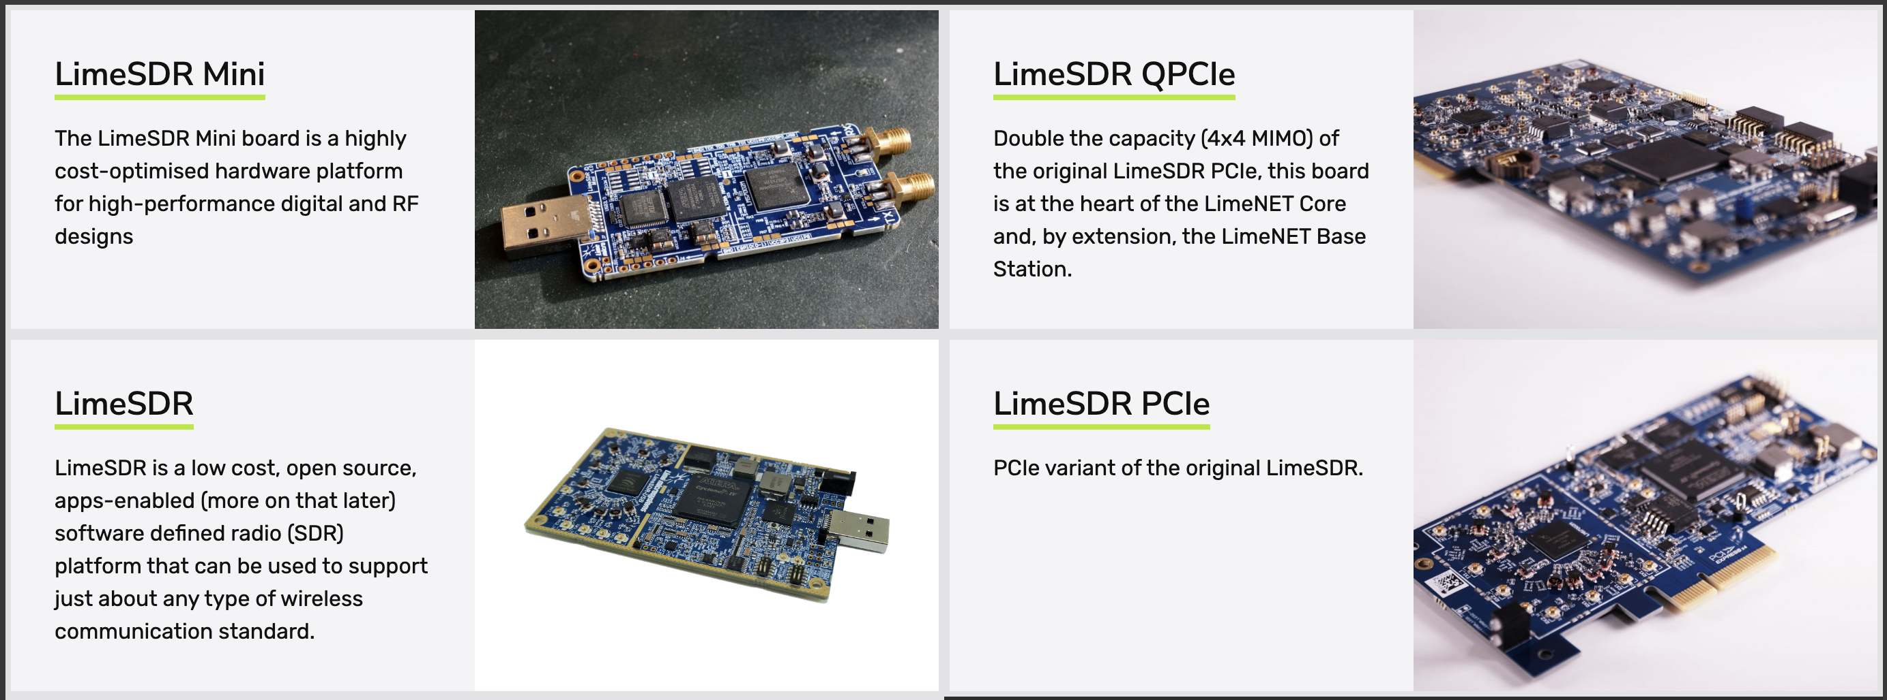
SDR
Lime Microsystems took over the XTRX (?)
Additional Options:
Source: https://limemicro.com/products/boards/

Slide 29
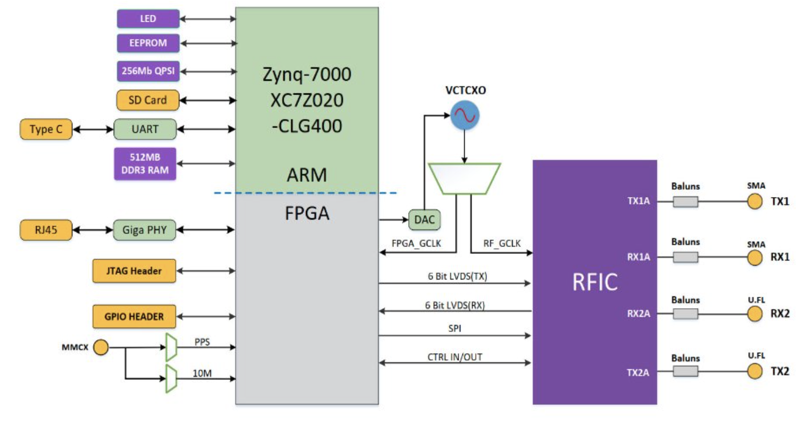
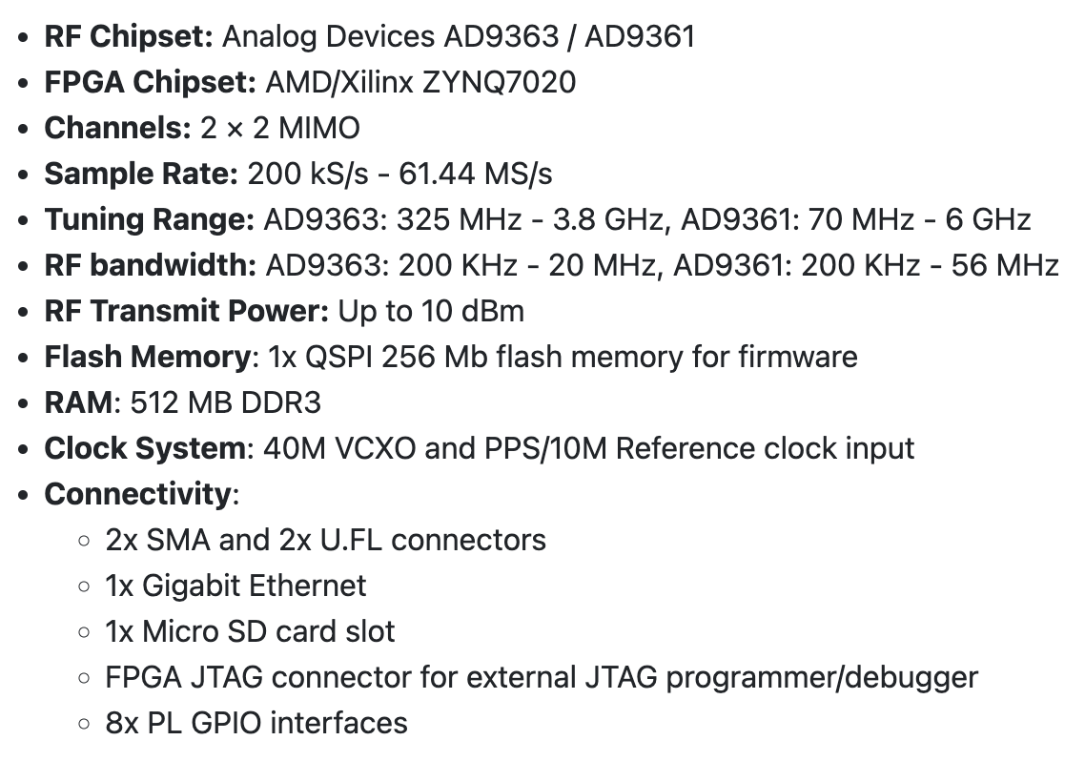
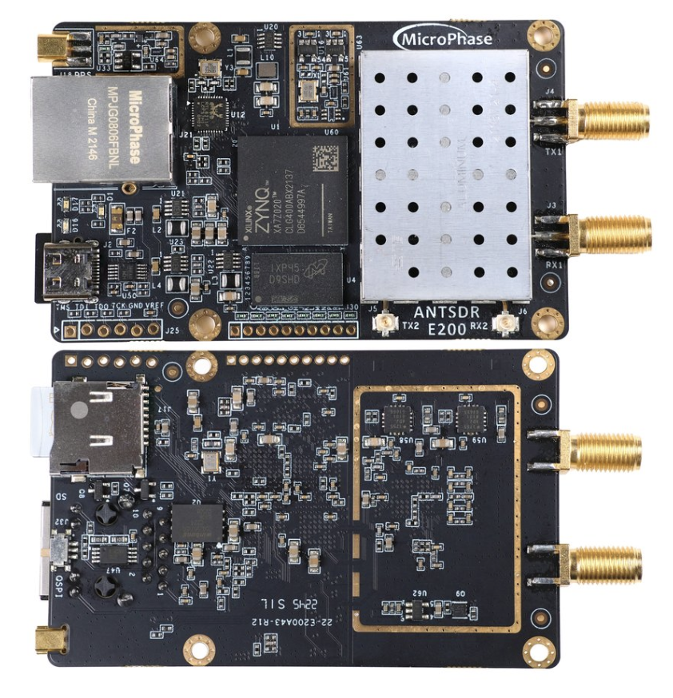
SDR
AntSDR E200

